Slide 1
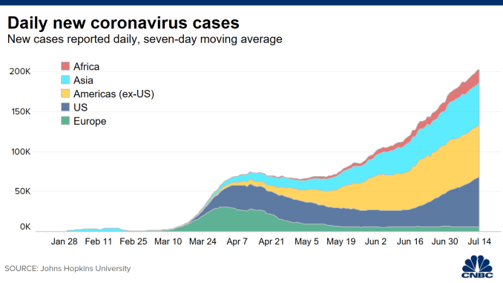
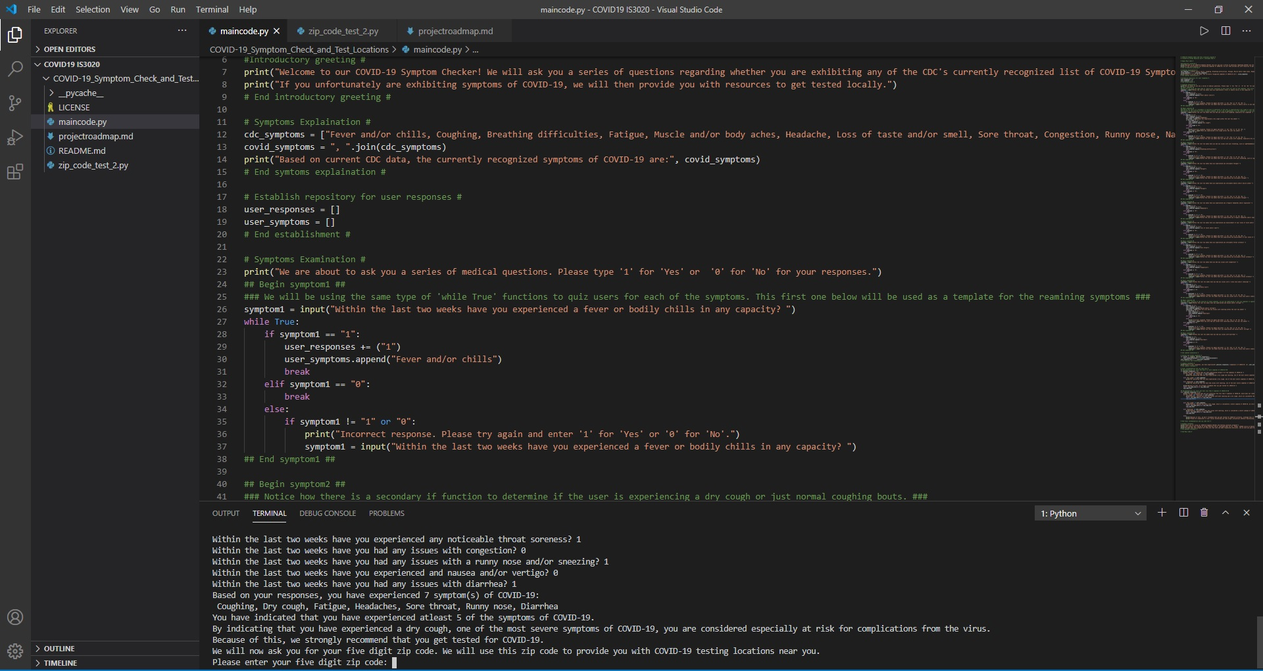
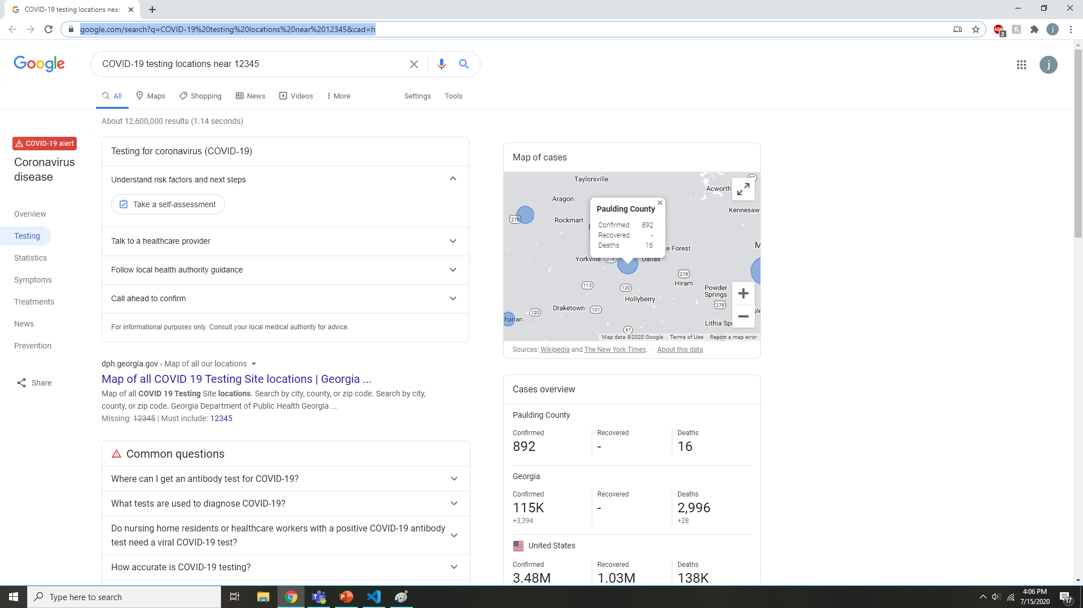
COVID-19 Symptom Checker and Test Locations
Program that allows you to see if you are exhibiting symptoms of COVID-19 and find out where to get tested locally if you are.
Coded by Jeremy Meyerson and M. Ishtiaque Khan.
Inspiration taken from https://github.com/ksu-is/Medical-Symptom-Checker
Our repository is https://github.com/ksu-is/COVID-19_Symptom_Check_and_Test_Locations

